Slide 1
Dandelion Group Project
Weather Observation Examples (WOE)
Sprint 1 Product Increment Presentation

Slide 2
The Project Outline
The team was given a group project to implement with Scrum and Agile.
Eric Rebelos approved the project to ingest and display BOM Weather observations using the following technologies:
Django version 4.2.9 with Python 3.11
Celery Beats 2.5.0
Github public version
SQLite3 (as provided by PyCharm and Django)
Chart.js
Python and Django native unit tests.

Slide 3
Project Initiation
The following tasks were captured as issues in the Github Project (link at the bottom of slide)
Ensure all contributors could access the repository in Github
Create the Initial Product Backlog
Complete Team Role assignments (who prefers to do what) for UI, Business Logic, CSS, Testing, Documentation, and Extract Transform, Load (ETL)
Verify Technology Selection (see previous slide)
Save observations for test data from BOM
Project initiation tasks were completed middle of day 2 of sprint 1.
Source: https://github.com/users/mrcrowley42/projects/1

Slide 4
Initial Product Backlog
The backlog was captured in an Excel spreadsheet with User stories being broken down in to
Epics and Features.
User story: | Admin (as an administrator I want to)
A1 |  | View the screens only I can see
A2 |  | Store, view and update the configurations - add to the URLs that are being used for observations
A3 |  | Activate and deactivate URLs for download
A4 |  | Restart the web service?
 |  | Immediately kick off a download of observations
User story: | User (as a regular user I want to)
U1 |  | View but not change raw observation data
U2 |  | View a list of observation locations in a drop down list and select one location
U3 |  | View a list of observation locations in a drop down list and select two locations to compare
U4 |  | View the data for one observation as a name value pair, in a table with four columns - Column A = observation name. Column B = observation value Column C = observation name. Column D = observation value
U5 |  | Filter selected observations for charting - start date to end date, different value series on the same chart - temperature, wind speed, wind direction, dew point depression
U6 |  | View a chart for one location. If two locations are selected, view the first chart above the second chart. Do not try to put all the data on the same chart
U7 |  | View a chart for TWO locations but only one value such as wind speed. The data will appear on one chart
User story: | Developer (as a developer I want to)
D1 |  | Upload archived data for testing and verification
D2 |  | Run tests from the web browser to determine system health - could be unit tests
This image is the initial product backlog. All new items are added to the Kanban board.
See next slide

Slide 5
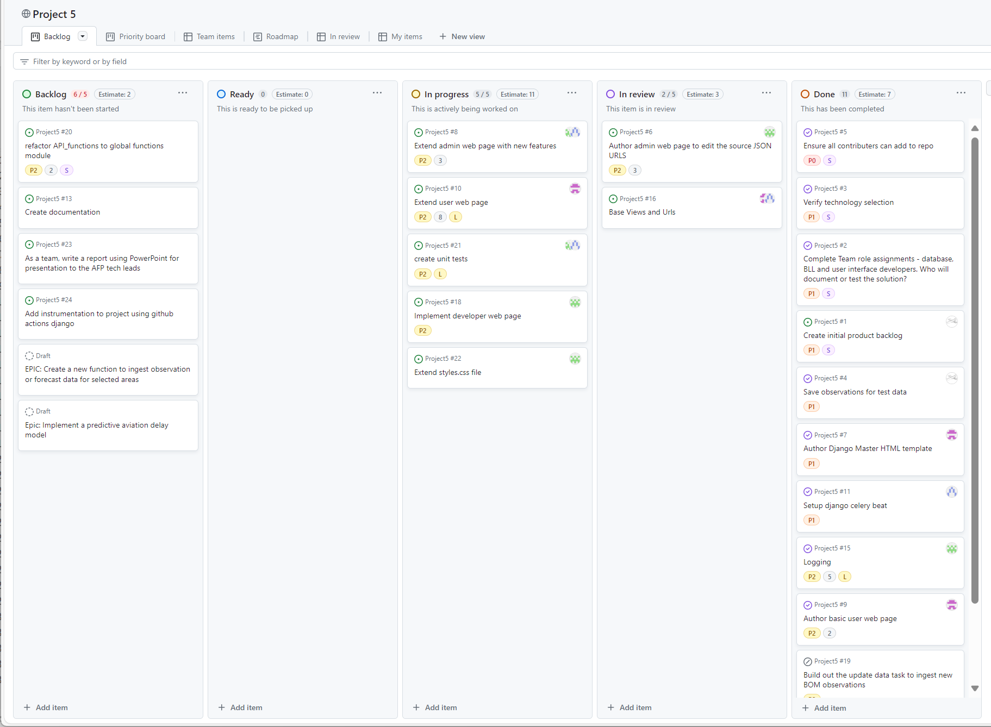
End of Sprint 1 Kanban Board
Source: https://github.com/users/mrcrowley42/projects/1/views/1

Slide 6
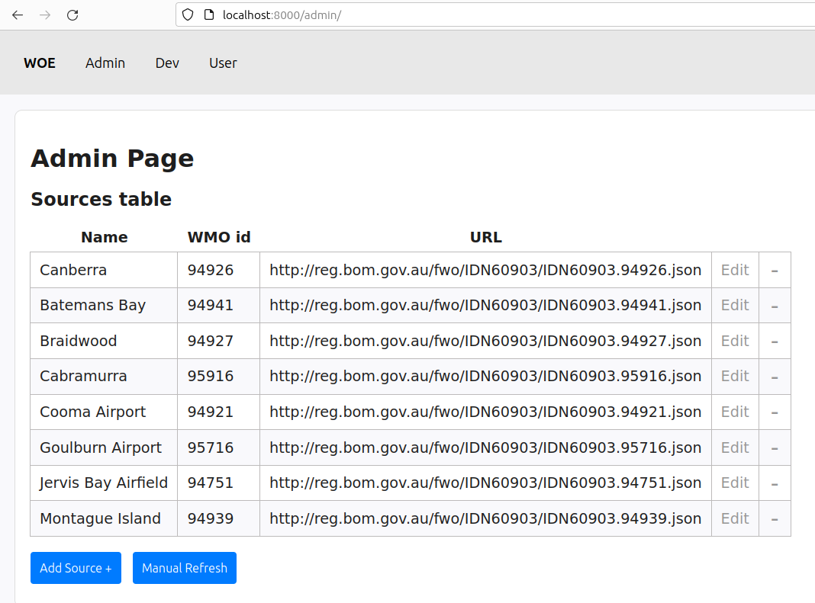
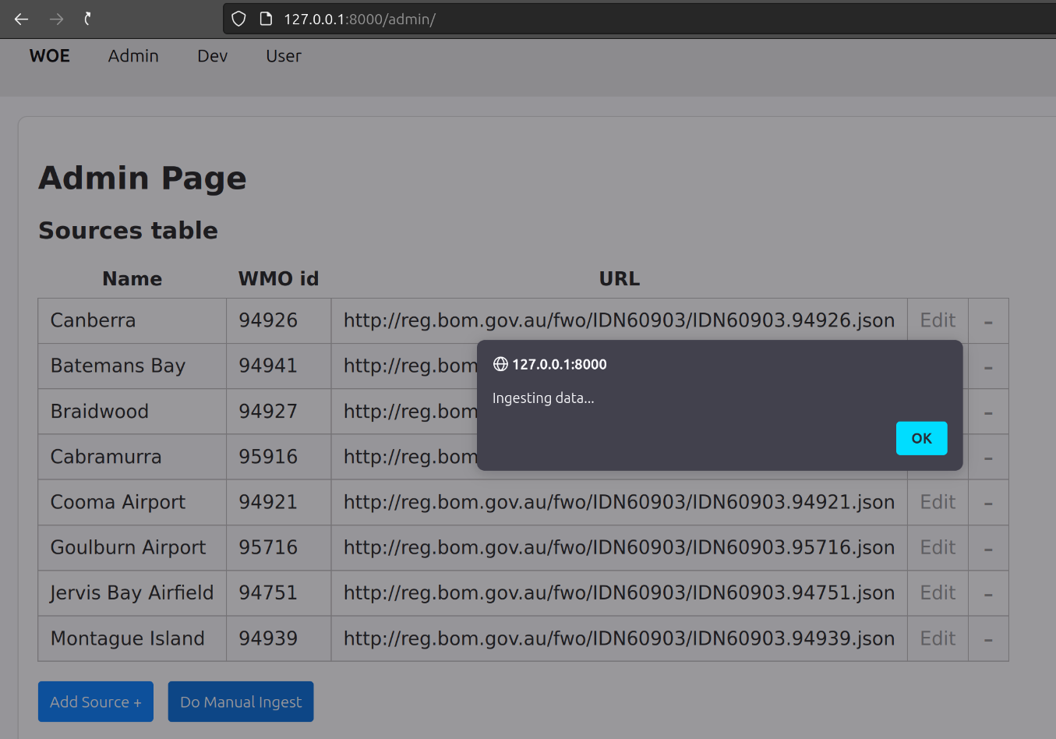
Functions Implemented - Admin
Admin Page
Displays the content of the Sources table.
Admin can add new sources.
Admin can edit or delete (‘-’) sources
Admin can kick off manual ingestion of BOM API data.

Slide 7
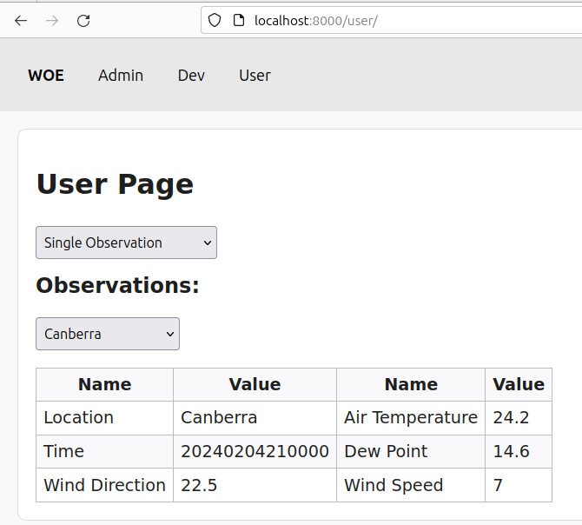
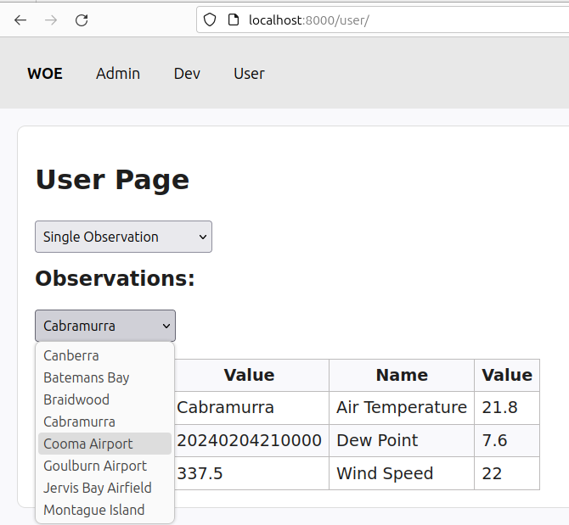
Functions Implemented - User
User Page
Displays the content of one Observation table row
User can select one location observation

Slide 8
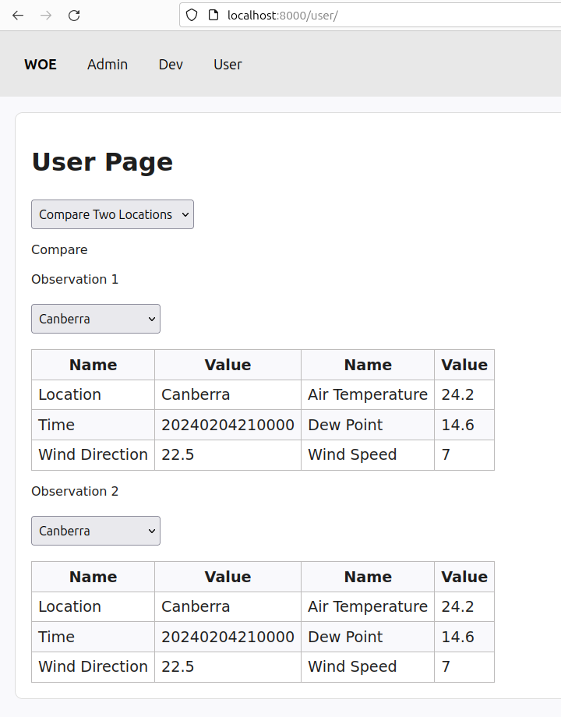
Functions Implemented - User
User Page
Displays the content of the Observation table
User can compare two locations’ observations

Slide 9
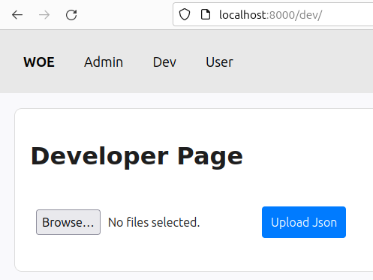

Functions Implemented - Developer
Developer Page
Provides a file dialog box that allows user to upload json files to be directly ingested into the database.

Slide 10
Slipped to next sprint
Charting of historical observations – chart data is emitted but the client side implementation with chart.js is not ready yet
Unit tests – coverage is not yet very high
Documentation of the existing implementation

Slide 11

Suggestions for next sprint plan
Complete the charting
Investigate ingesting forecast data from Open Weather Map API
Thanks for attending the Sprint 1 Product Increment presentation

